Slide 1
Lab 4
ITEC618 Labs
Programming Concepts
Dr. Farshid Keivanian

Slide 2
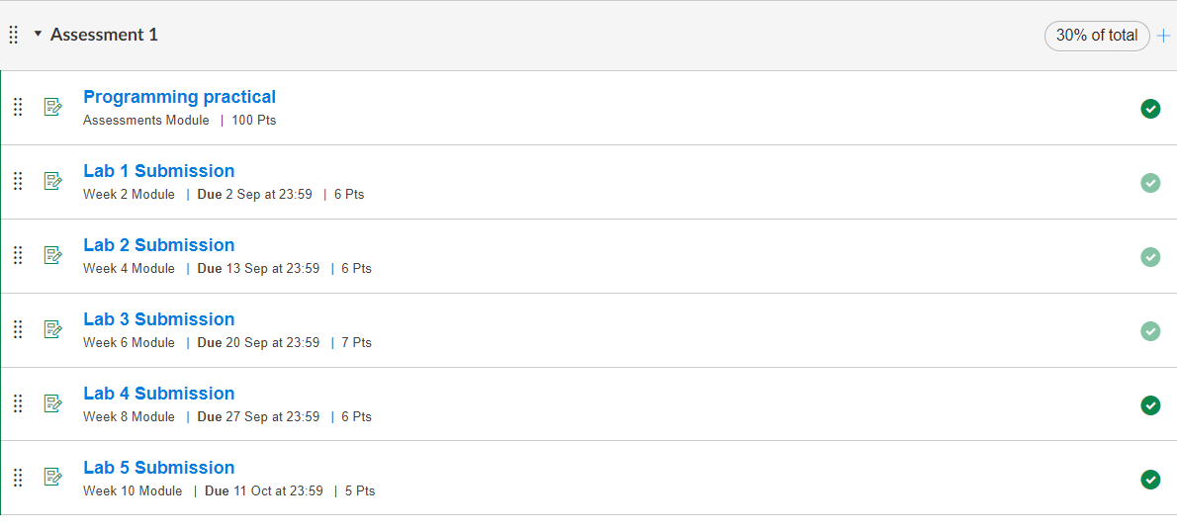

Slide 3
Task completion (3%)
Task completion (3%)
8.1 (1%) (Article Statistics) Write a program that will count the number of characters, words, and lines in a text file, e.g., a news article etc. Words are separated by whitespace characters. The file name should be passed as a command-line argument, as shown in the figure below. Feel free to make your own sensible text file for testing and choose your file name. Show lab tutor the working of your program.
Hint: make sure you fully understand and can run all code examples in the ‘Lecture 5 Slides - Text I/O’. Using a scanner linked with the text file, you can read in the file line by line until no line is left (so total line count can be found) and for each line as a string you can count and add up the split characters and words with String operations or methods of String class in Java API.

Slide 4
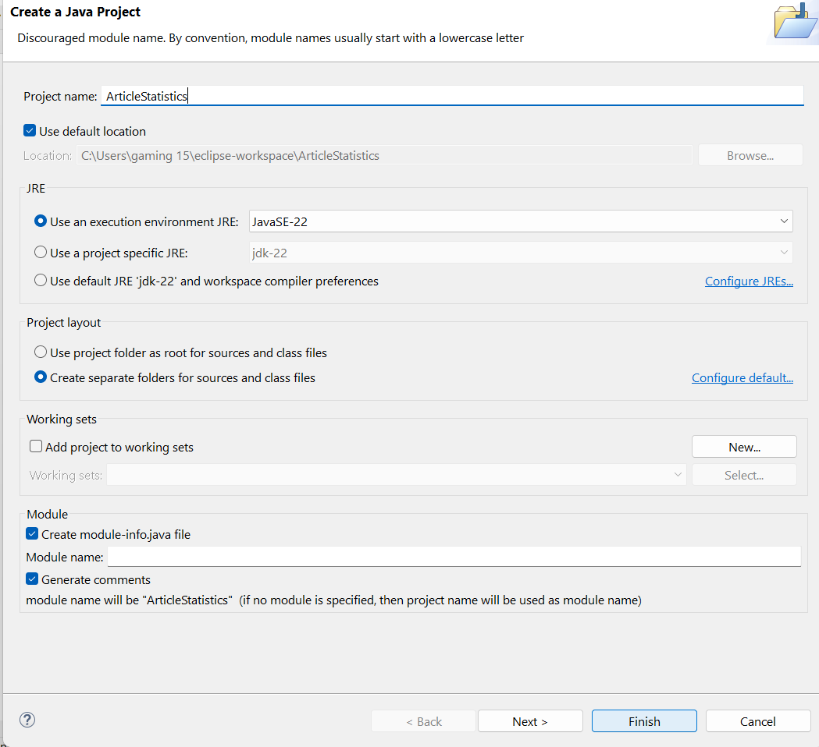
Task completion (3%)
1. Create a New Java Project
Open Eclipse.
Go to File -> New -> Java Project.
Name your project something like ArticleStatistics and click Finish.

Slide 5
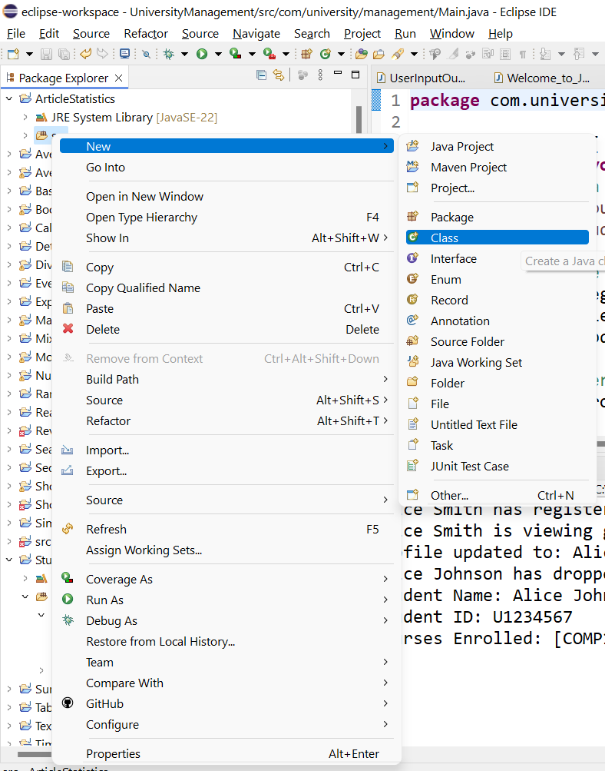
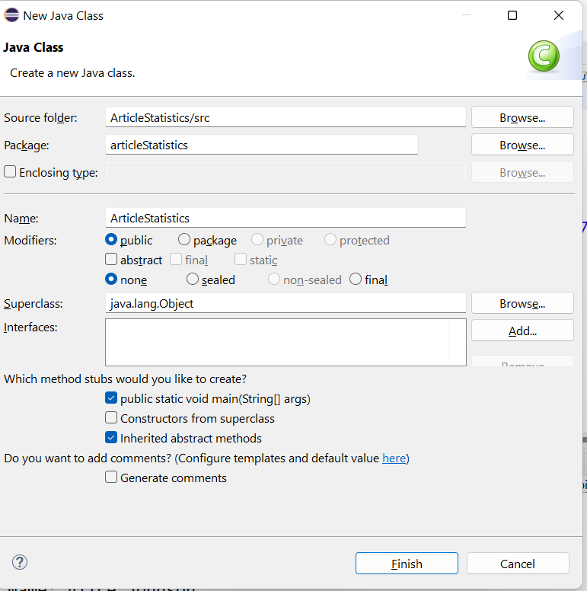
2. Create a New Java Class
Right-click on the src folder in your project.
Select New -> Class.
Name your class ArticleStatistics.
Check the box for public static void main(String[] args) and click Finish.

Slide 6
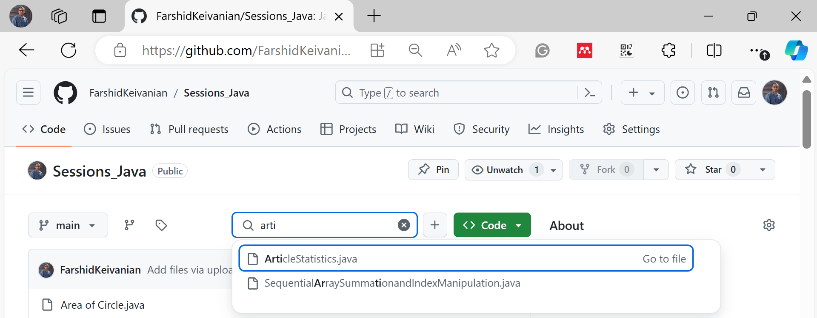
3. Write the Program Now, write the following Java code to achieve the task:
C:\Users\...\eclipse-workspace\ArticleStatistics\src\articleStatistics

Slide 7
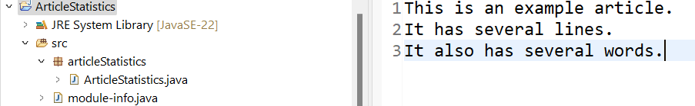
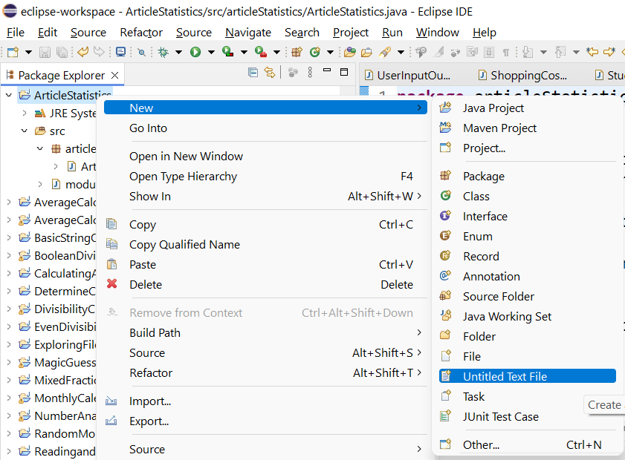
4. Create a Text File
Create a text file (article.txt) in your project folder. You can add some lines of text for testing.
Example content

Slide 8
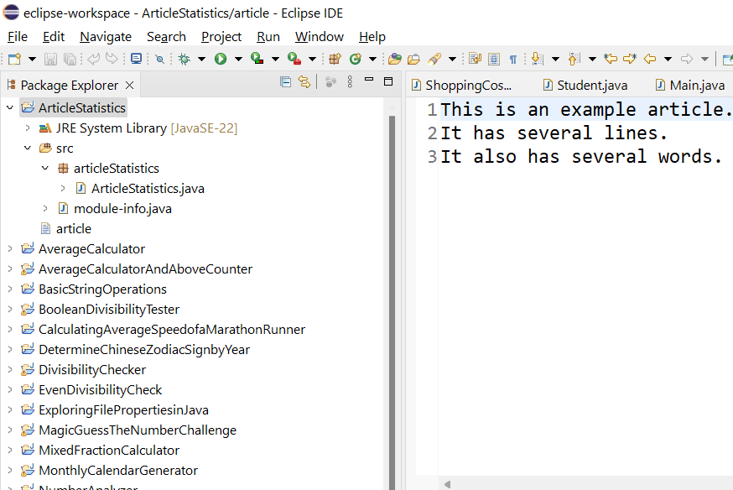
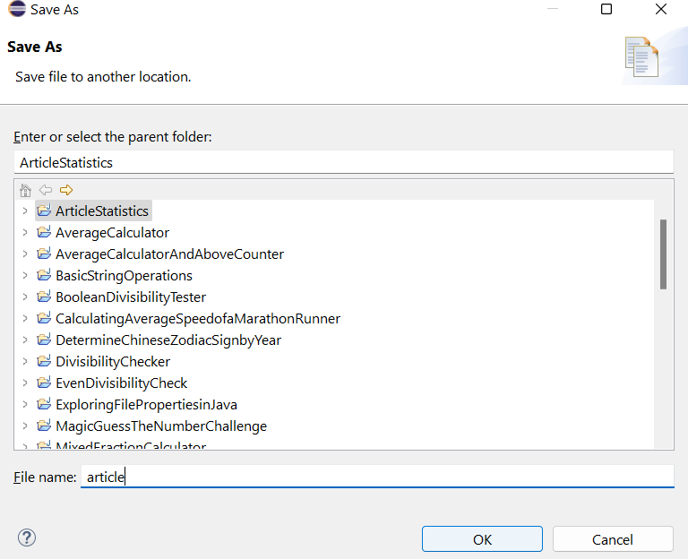
4. Create a Text File
Create a text file (article.txt) in your project folder. You can add some lines of text for testing.
Example content

Slide 9
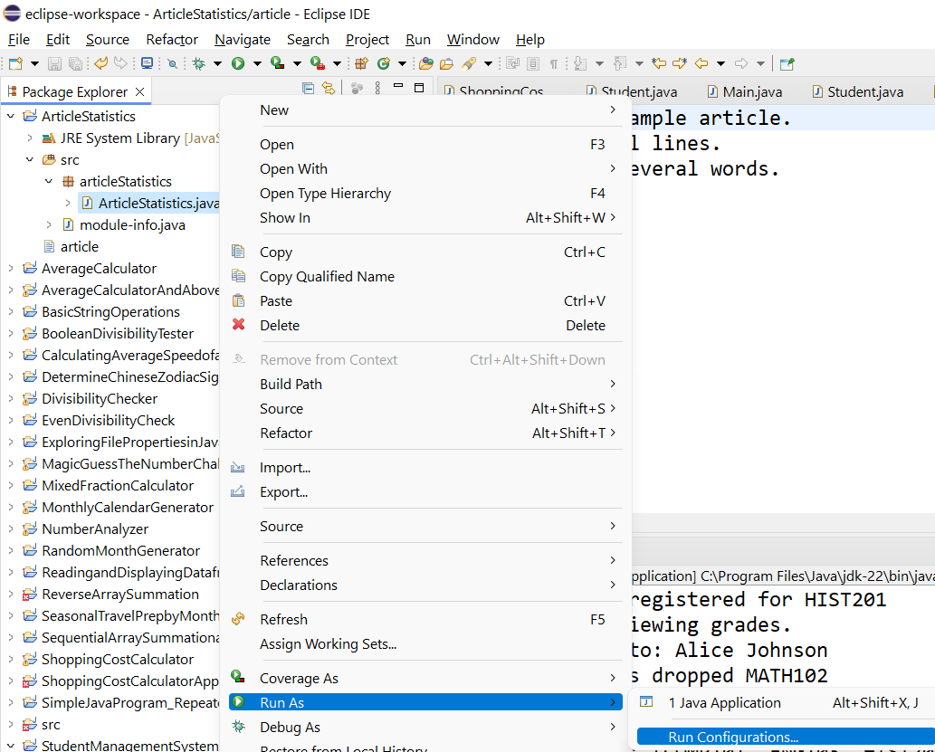
5. Run the Program with Command-Line Arguments
Right-click on your class ArticleStatistics in Eclipse.
Go to Run As -> Run Configurations.
In the Run Configurations window, select the Arguments tab.
In the Program Arguments field, enter the name of the file you want to process, for example: article.txt

Slide 10
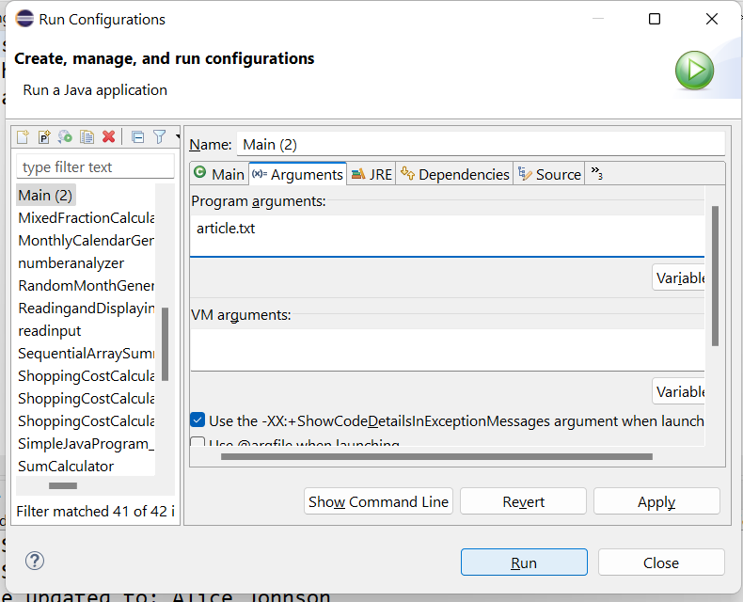
5. Run the Program with Command-Line Arguments
Right-click on your class ArticleStatistics in Eclipse.
Go to Run As -> Run Configurations.
In the Run Configurations window, select the Arguments tab.
In the Program Arguments field, enter the name of the file you want to process, for example: article.txt

Slide 11
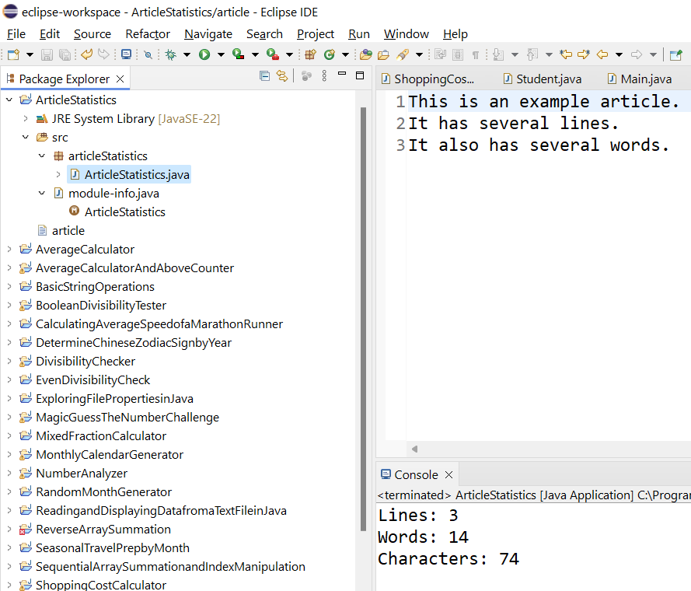
5. Run the Program with Command-Line Arguments
Right-click on your class ArticleStatistics in Eclipse.
Go to Run As -> Run Configurations.
In the Run Configurations window, select the Arguments tab.
In the Program Arguments field, enter the name of the file you want to process, for example: article.txt

Slide 12
Minor Change to Show Skills – Send it through an email: Farshid.Keivanian@acu.edu.au
To demonstrate extra skills, students could exclude punctuation marks from the word count. A minor modification can be made in the program by updating the line splitting logic:
wordCount += line.replaceAll("[^a-zA-Z ]", "").split("\\s+").length;
This line replaces all non-alphabetic characters with an empty string before counting the words. It helps to filter out punctuation.

Slide 13
8.2 (1%) (Arrays of Digit Counts) Write a method that finds how many times each unique digit in a number appears using the following header:
public static int[] count(long num)
The method counts how many times a digit appears in a long number. The return value is an array of ten elements, each of which holds the count for a digit (0 to 9). For example, after executing int[] counts = count(122033), counts[0] is 1, counts[1] is 1, counts[2] is 2, and counts[3] is 2. Write a test program that prompts the user to enter a number and displays the number of occurrences of each digit in the number. Below is a sample run.
Hint: you can convert the long number to a string and extract and parse the digits from characters in the string for updating the digit counts. You can refer to the methods of Character class in Java API to get the numeric value of a digit character or use parseInt method in the Integer class in Java API if each digit character is extracted as a substring.
Enter a number: 232311234
Digit 1 occurs 2 times
Digit 2 occurs 3 times
Digit 3 occurs 3 times
Digit 4 occurs 1 time

Slide 14
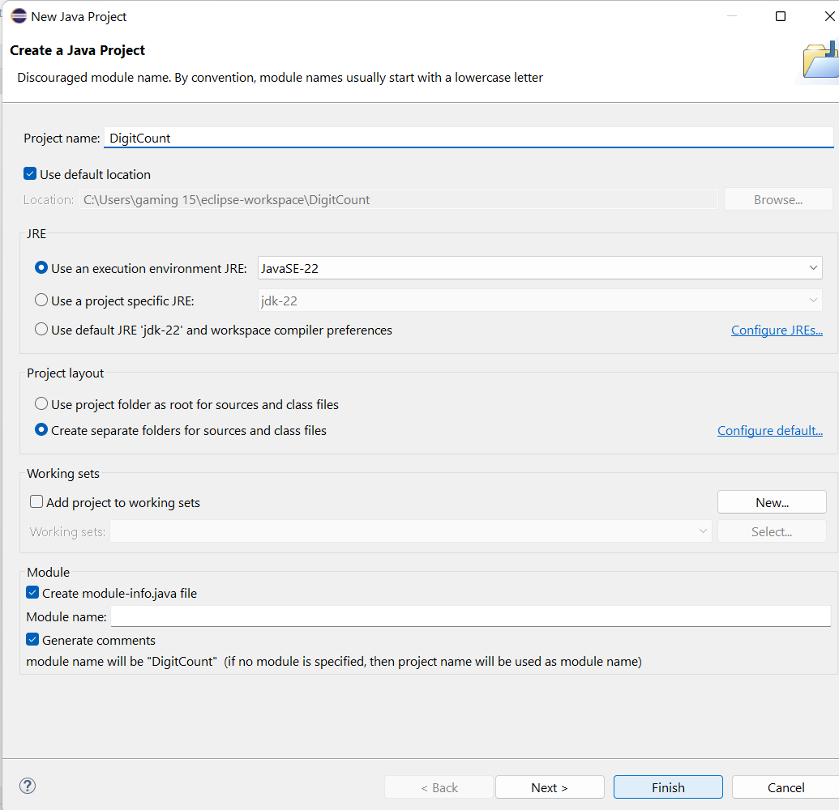
1. Open Eclipse:
Open Eclipse and create a new Java project: DigitCount

Slide 15
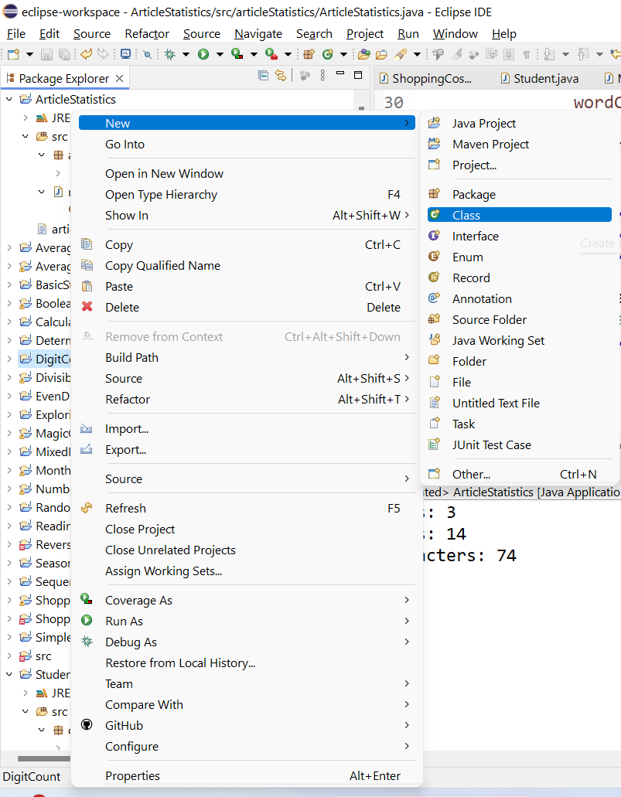
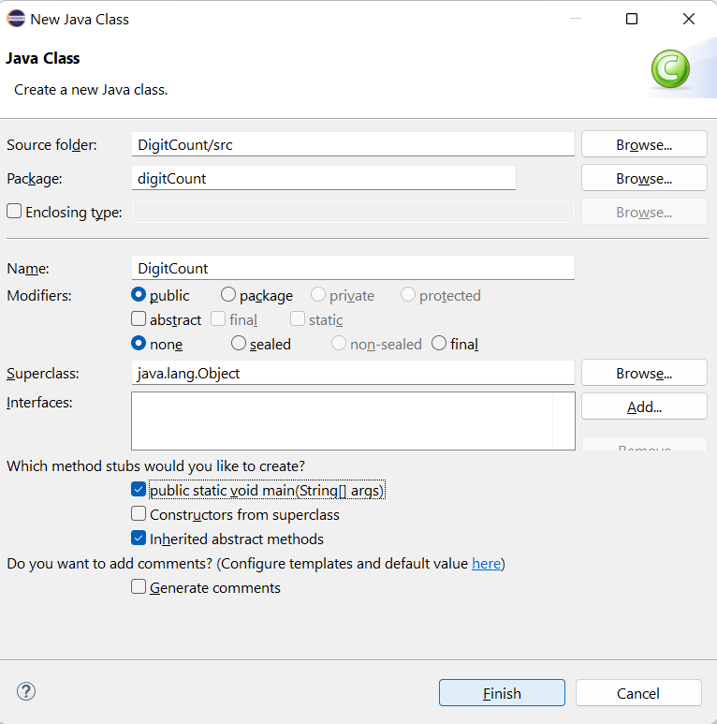
2. Create a New Class:
Right-click on the src folder and select New > Class.
Name the class DigitCount and make sure to check the option to include the main method.

Slide 16
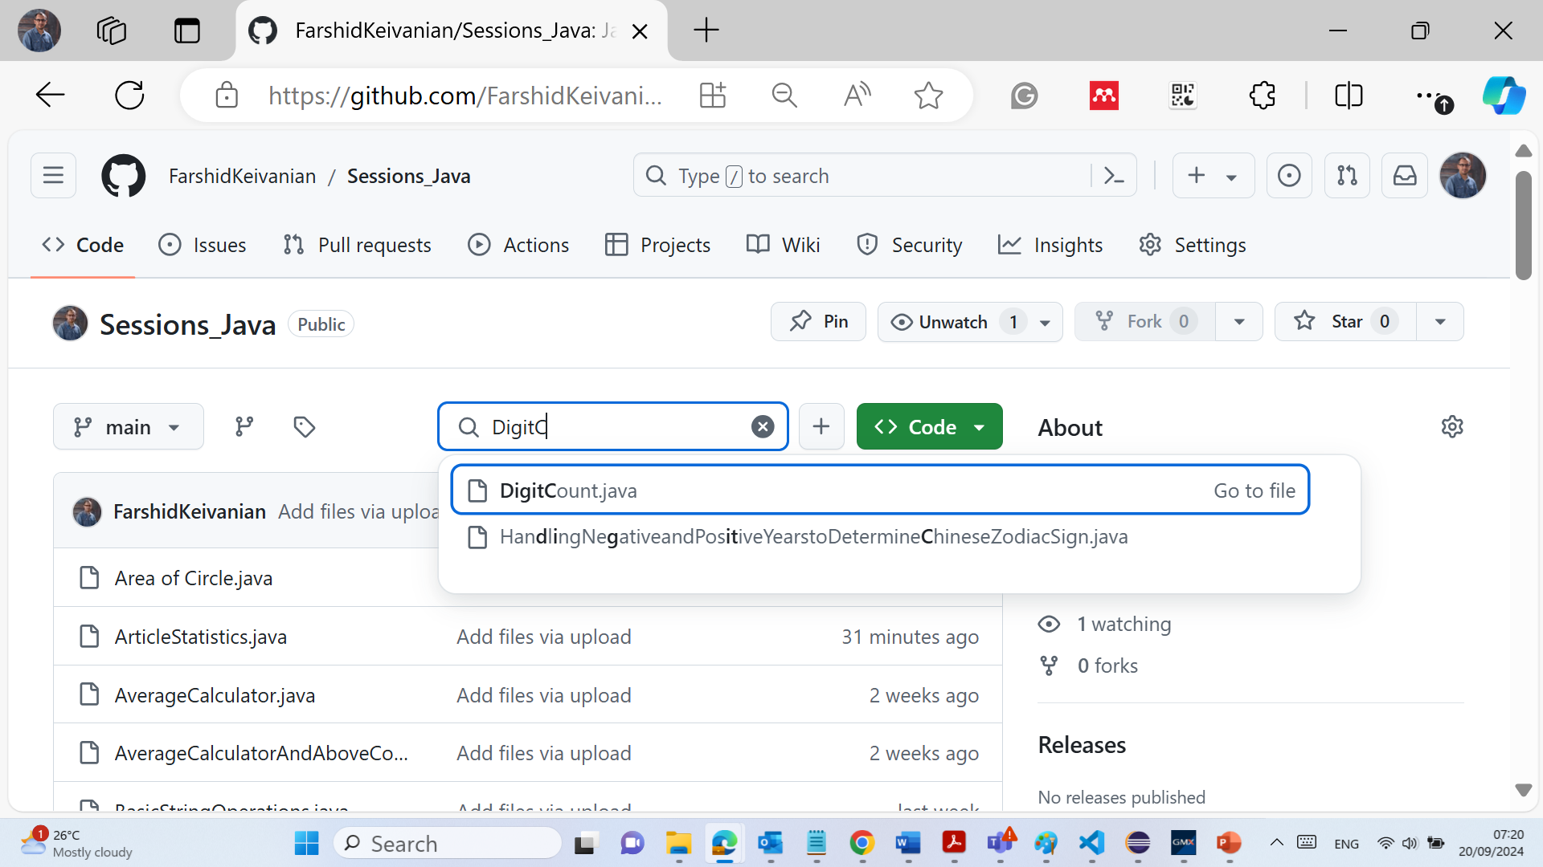
3. Write the Program:
Below is the program that fulfills the requirement.
Method count(long num): This method takes a long number, converts it to a string, and counts how many times each digit (0-9) appears. It returns an array where the index represents the digit, and the value at that index represents how many times the digit appeared in the number.
main method: It prompts the user to enter a number, calls the count method, and displays the occurrences of each digit.

Slide 17
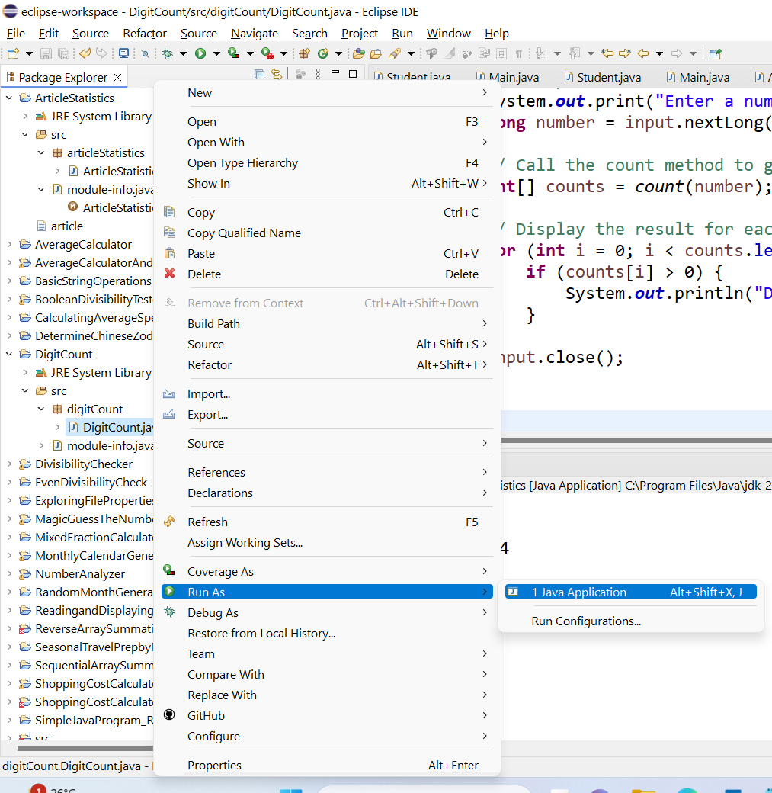
4. Run the Program:
1. After pasting the code into the DigitCount class, save the file.
2. Run the Program:
Click the Run button or right-click on the class file and select Run As > Java Application.

Slide 18
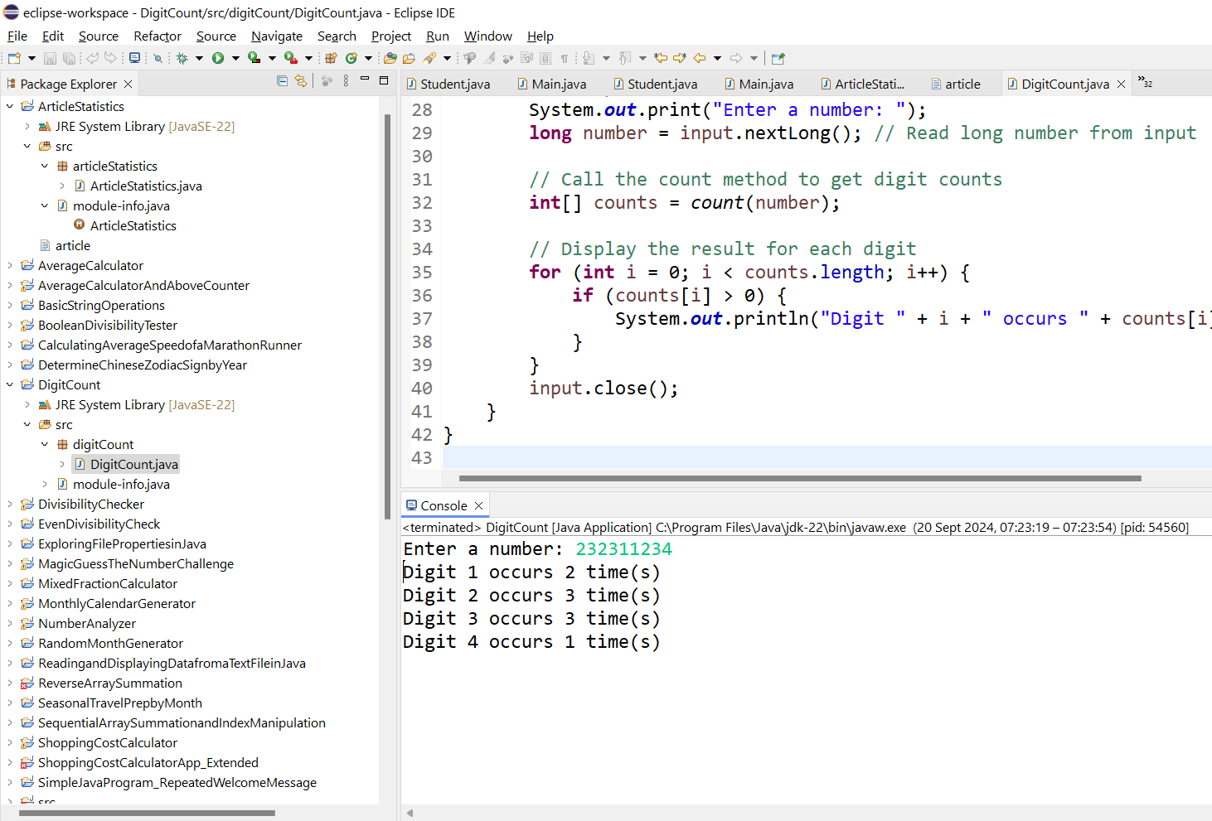
4. Run the Program:
1. After pasting the code into the DigitCount class, save the file.
2. Run the Program:
Click the Run button or right-click on the class file and select Run As > Java Application.

Slide 19
Minor Change to Show Skills – Send the code and screenshot of results through an email: Farshid.Keivanian@acu.edu.au
A minor change students can implement to show their skills is to handle negative numbers properly by converting them to positive:
num = Math.abs(num); // Convert the number to positive

Slide 20
8.3 (1%) (Common Letters) Write a program that prompts the user to enter two arrays of alphabets/characters and finds and displays the common letters that appear in both arrays. Note that the first highlighted number in the user input below indicates the number of elements in an alphabet array.
Hint: the highlighted numbers basically denote how many times a Scanner should read next (i.e., singlecharacter strings) to get the complete list input from user. In addition, the retainAll method in the ArrayList class can help the program to be written more efficiently.
Here is a sample run:
Enter list1: 5 c a b d e
Enter list2: 7 f c a d p q z
The common elements are: c a d

Slide 21
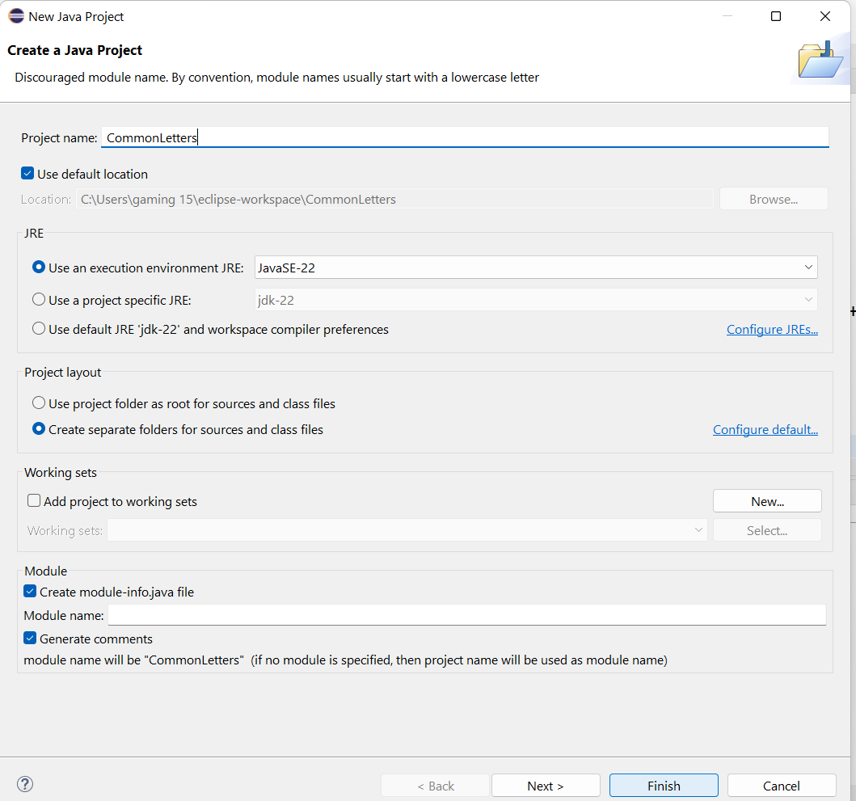
1. Open Eclipse:
Open Eclipse and create a new Java project: CommonLetters.

Slide 22
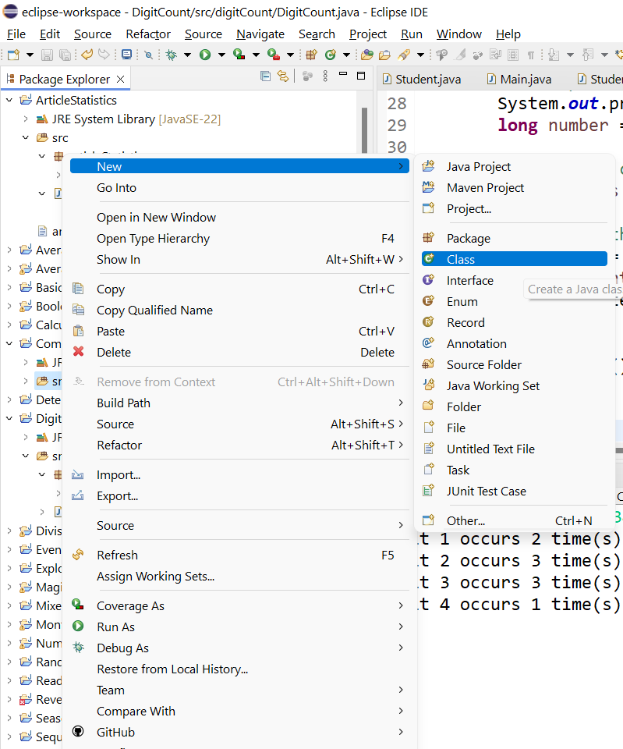
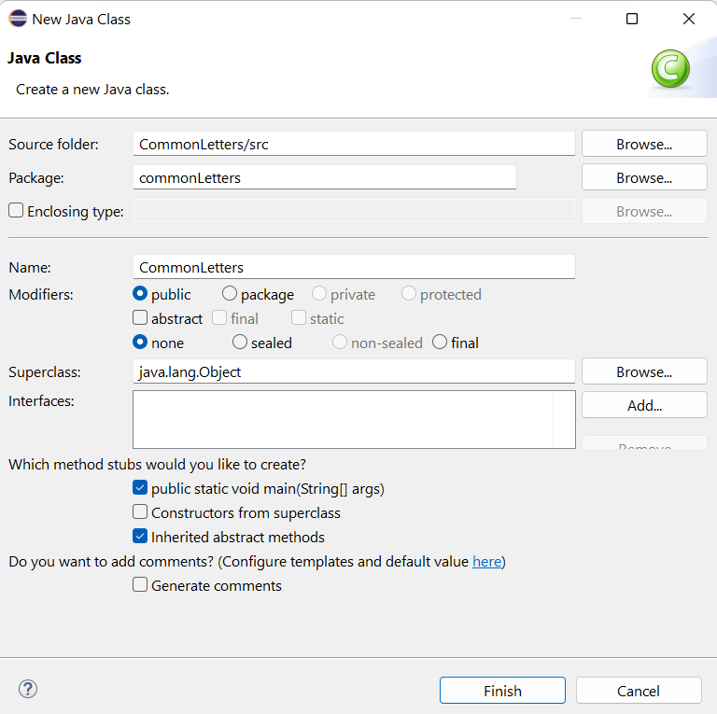
2. Create a New Class:
Right-click on the src folder and select New > Class.
Name the class CommonLetters and check the option to include the main method.

Slide 23
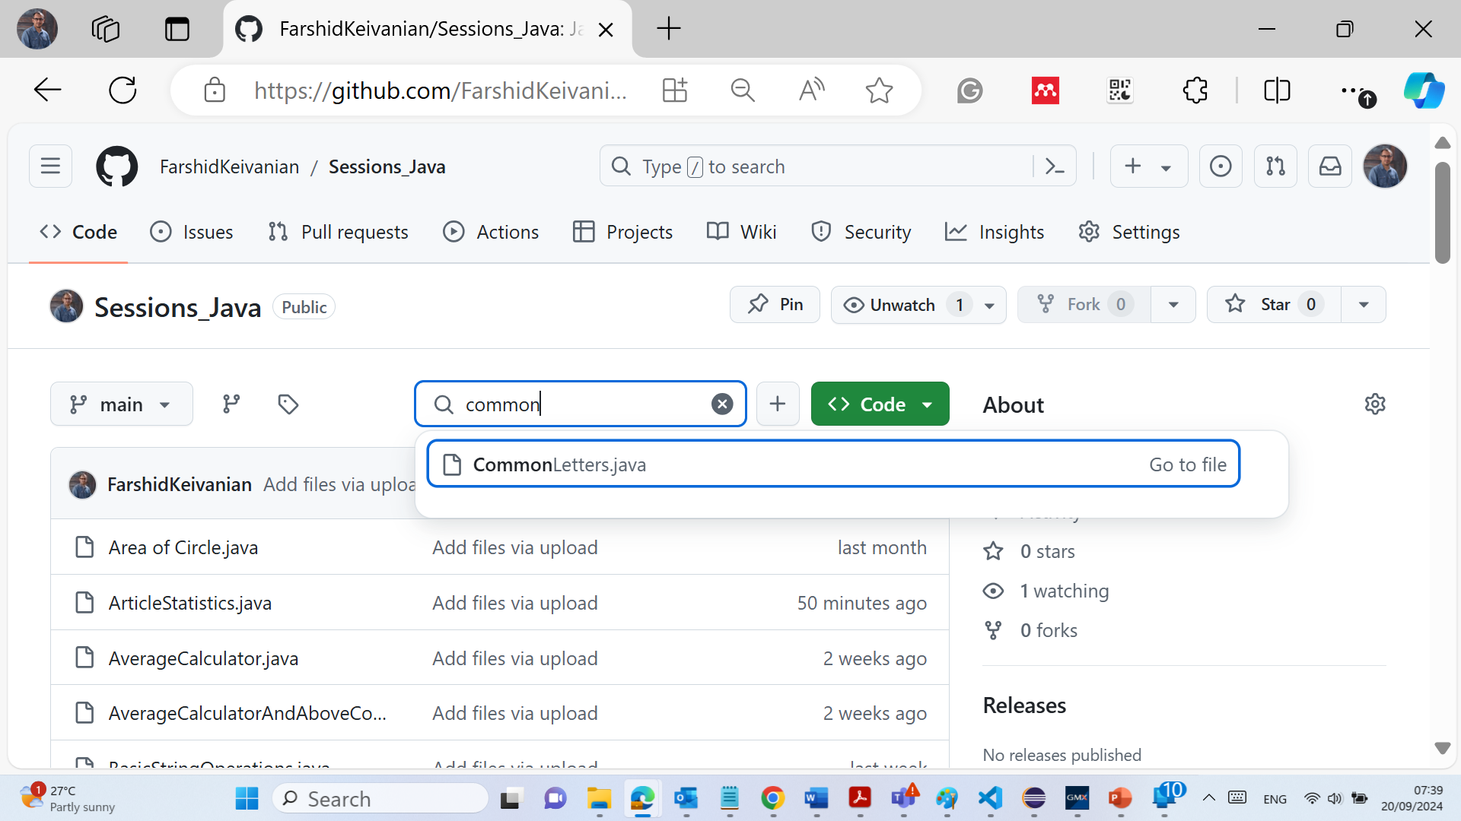
Write the Program:
Below is the code that accomplishes the task of finding common letters between two arrays.

Slide 24
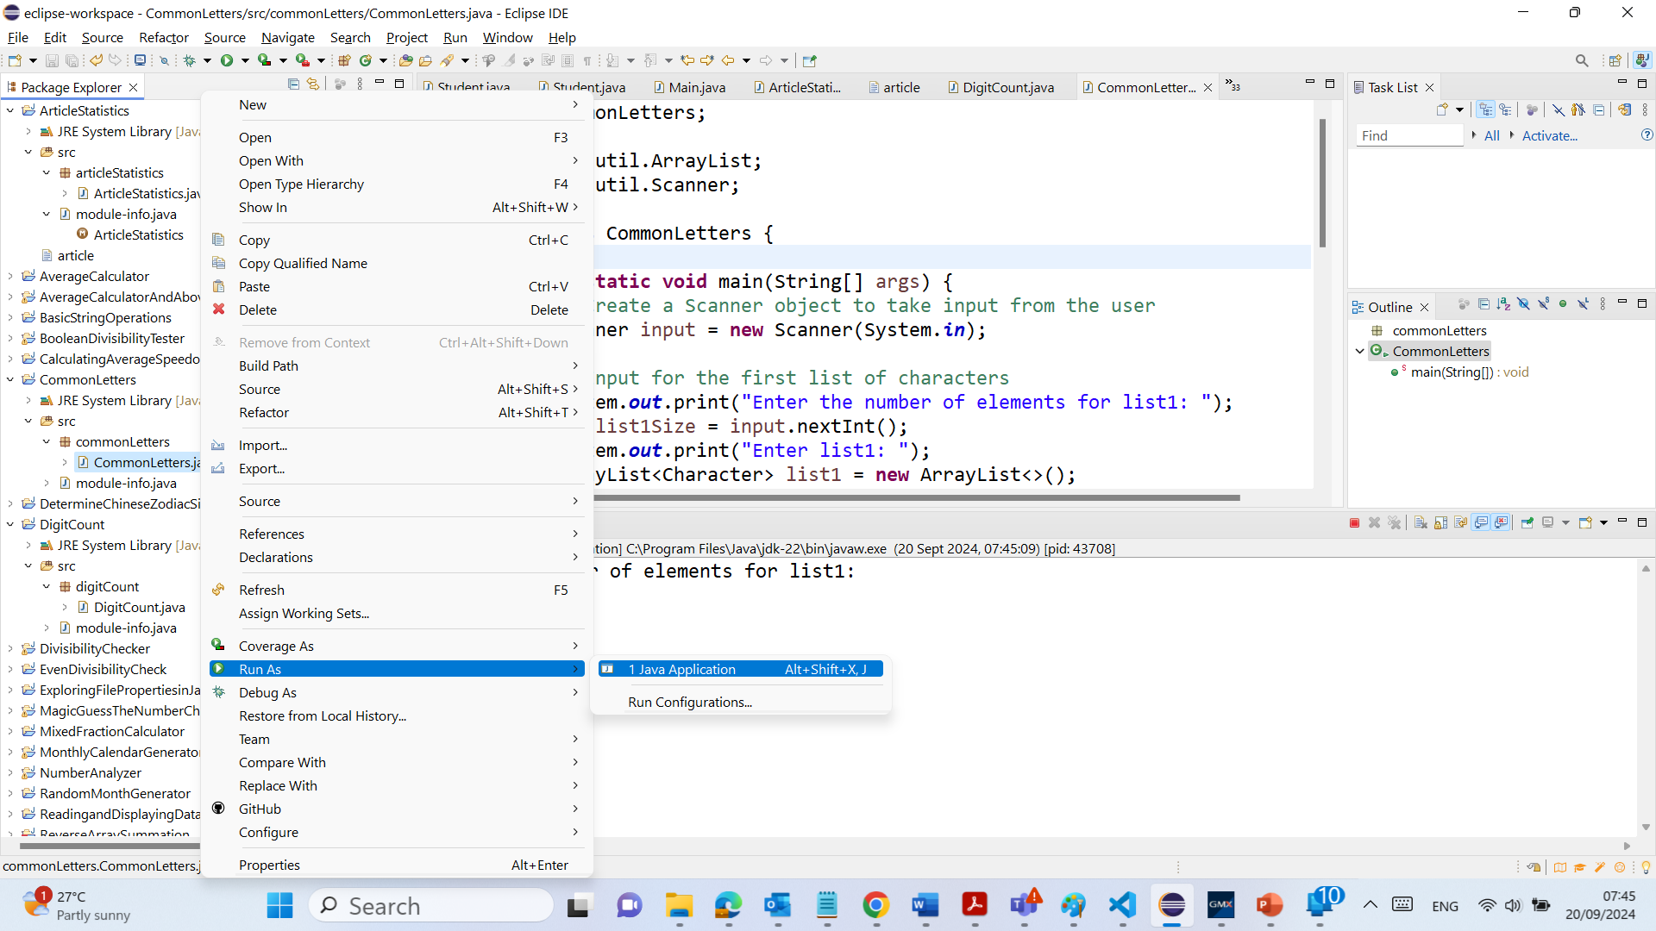
Run the Program:
Rght-click on the CommonLetters.java file and select Run As > Java Application.

Slide 25
Explanation
1. Input for List 1:
The user is prompted to enter the number of elements for the first list, followed by the characters. Each character is read using Scanner.next(), converted to a char, and stored in an ArrayList<Character>.
2. Input for List 2:
Similarly, the user enters the size and characters for the second list, which is stored in another ArrayList<Character>.

Slide 26
Explanation
3. Finding Common Letters:
The retainAll() method is used to find the common elements between the two lists. This method modifies list1 to keep only elements that are also present in list2.
4. Displaying the Result:
The program prints the common letters between both arrays.

Slide 27
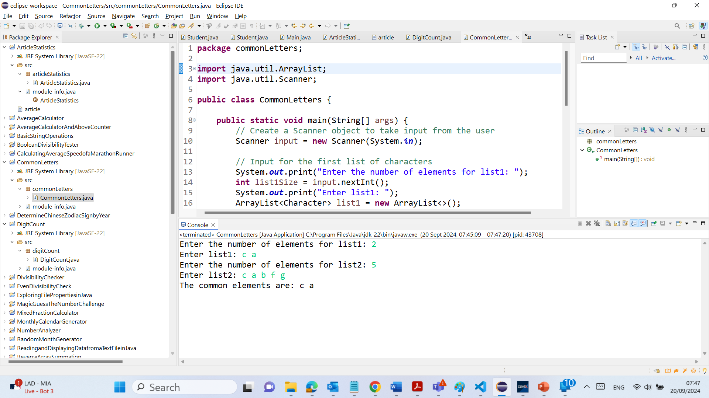
Output

Slide 28
Minor Change to Show Skills – Send the code and screenshot of results through an email: Farshid.Keivanian@acu.edu.au
A simple enhancement students can make to show their skills is to convert both arrays to lowercase before comparing, ensuring that case sensitivity is not an issue:
list1.add(Character.toLowerCase(str.charAt(0))); // Convert to lowercase before adding
list2.add(Character.toLowerCase(str.charAt(0))); // Convert to lowercase before adding

